Slide 1
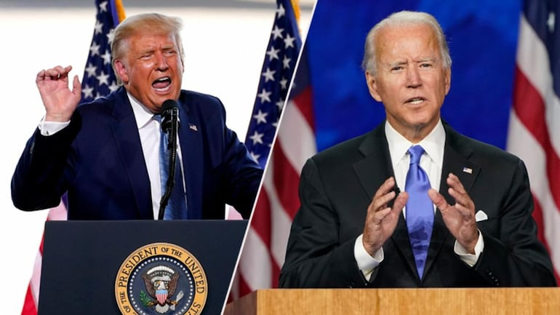
Impact of Elections on the Economy
The General Elections In November 2020

Slide 2
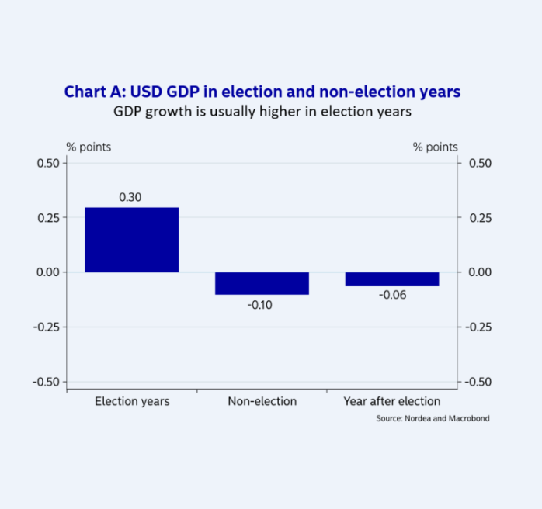
Background
The U. S. economy faces uncertainty every election year due to the general confusion created by passionate supporters.
As presented by individual candidates, the policies provide an overview of how the next administration is going to influence the business environment.
The most significant concerns for investors include regulatory policies, interest rates, government spending, and public debt.
Candidates’ incentives translate to slight growth in the economy in the runup to elections.
Notes:
Every election year, the U. S. and extensively the global markets face possible confusion, and partisan supporters voice out their passionate and attentive concerns and beliefs, creating uncertainty in investors. However, despite the drive to clinch the win and the passionate electorate, the biggest concern for investors, are the individual candidates' policies and how the next administration will influence their productivity (Kingsly, 2016). In addition to the promises of economic expansion and employment creation, investors' concerns revolve around additional factors like the regulatory policies, interest rates, government spending, and the public debt (Kingsly, 2016). Generally, the United States' business environment behaves calmly in the runup to an election, with data showing a tendency for the market to encourage economic gain due to the little incentives spearheaded by individual candidates (Kingsly, 2016).

Slide 3
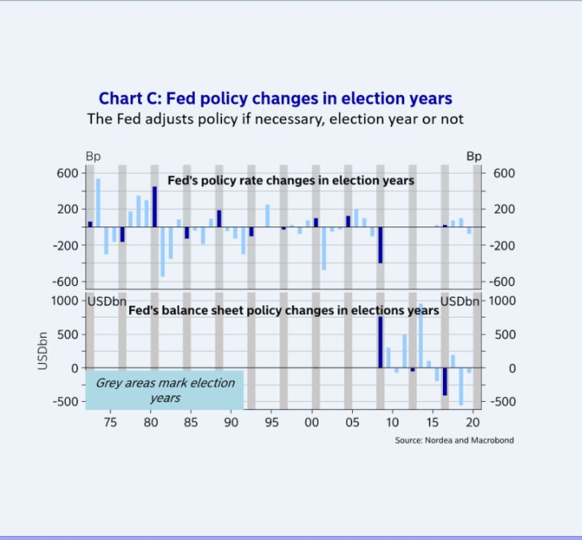
Current Situation
The November 2020 elections seem to have created different economic results, unlike the other election years.
Changes in fiscal policy, which stimulate economic growth, were initiated two to three years before the election year.
The hugely divided Congress is less likely to support changes in fiscal policy that could stimulate economic growth.
The perceived “election pause” by the Fed has created stability within the economy.
Notes:
The circumstances seem to be different in relation to the November 2020 elections due to certain reasons. Fiscal policy is often the driving force behind the slight economic growth in election years, contributing to a 0.4% growth in the economy and an average 0.3% growth in GDP (Lund & Svendsen, 2020). However, for the current administration, these fiscal policies were ‘offloaded’ two to three years before the election years (Lund & Svendsen, 2020). Though the move contributes to up to 0.5-1%-point growth in GDP, the economy was already experiencing growth, which resulted in contradictions in counter-cyclical fiscal balance (Lund & Svendsen, 2020). The second reason is the hugely divided Congress, meaning that the Democratic majority is less likely to support any economic stimulus. The third reason is the presumable “election pause” in the Fed, meaning that the Fed has not introduced any rate changes in this election year; unlike the eight out of twelve times, it has hiked rates during election years (Lund & Svendsen, 2020).

Slide 4
Critical Factors
The November 2020 election outcomes are anchored on three fundamental factors.
The economy is at the center, with the so-called Misery Index used to “predict” election outcomes.
The “moderate” Democratic candidate is also bound to cause significant market volatility.
The economics of swing states and their markets are bound to experience significant shifts as presidential campaigns focus on these.
Notes:
Therefore, three critical factors are set to define how the November 2020 elections in the United States will play out. The first is the economy, where the so-called Misery Index, which is the sum of unemployment rates and inflation in the country, is used to evaluate the economy and “forecast” possible election outcomes (Lund & Svendsen, 2020). The second factor is the Democratic candidature, a “moderate” Democrat, which is most likely to foster a volatile market. The third factor is the swing states, for instance, Michigan, Pennsylvania, and Wisconsin, which significantly influenced the 2016 elections (Lund & Svendsen, 2020). Therefore, since a disproportionately huge part of the campaigns will take place in these states, their markets and economics are bound to experience significant shifts (Lund & Svendsen, 2020).

Slide 5
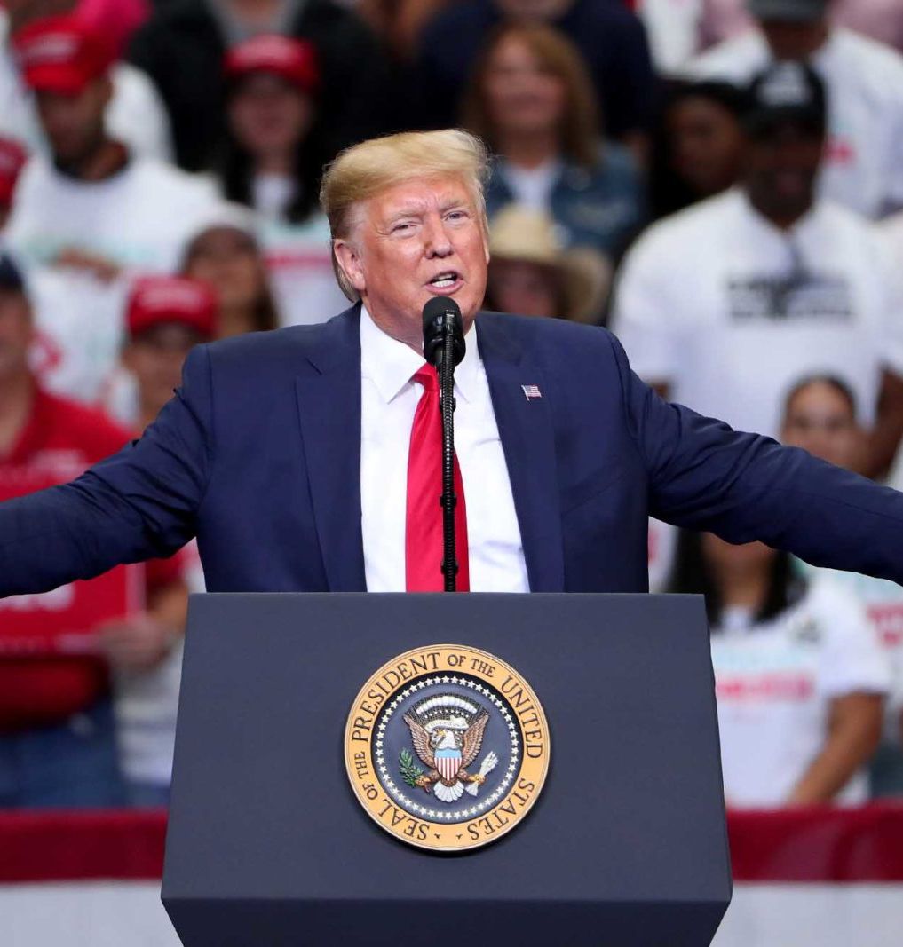
Implications of a Trump Win
President Trump’s reelection has been associated with positive economic performances and considerable economic growth.
The reelection may also cause a further slowdown in global manufacturing sectors, particularly car manufacturing in Europe.
The trade wars between the Trump administration and the East may continue to affect international trade.
Notes:
Wall Street analysts have described President Trump's reelection as the most favorable for the U. S. and global economies. These analysts argue that based on previous presidential reelections, which triggered positive economic performances, President Trump’s reelection would have similar effects (Bernstein, 2020). However, the opposite also seems to be true. For instance, the current administration's trade wars are largely blamed for the slowdown in global manufacturing sectors, particularly the car manufacturing industry in Europe (Lund & Svendsen, 2020). Additionally, the trade wars with the East, particularly China, have negatively affected international trade. Therefore, reelection would mean the continuation of the same.

Slide 6
Implications of a Trump Win (Cont.)
The value of the dollar is bound to increase significantly following Trump’s reelection.
Economic sectors bound to benefit most following Trump’s reelection include carbon energy sectors, big tech sectors, and renewable energy sectors.
The traction experienced in ESG investing is also bound to continue following the reelection.
By ensuring law and order, Trump’s reelection is bound to create conducive environments for businesses to thrive.
Notes:
Additionally, President Trump’s reelection is bound to contribute to a significant appreciation of the dollar due to the heightened trade tensions and the broader geopolitical uncertainty. Furthermore, various sectors, including carbon energy sectors, big tech sectors, and renewable energy sectors, are bound to perform better under a Trump reelection (Borowski et al., 2020). It is believed the ESG investing will also gain significant traction under Trump’s reelection, as increased disclosure and the accelerating ESG equity flows are bound to continue. Finally, the law and order theme that is characterizing the Trump reelection campaign is bound to create a conducive environment for U. S. businesses to thrive and pull investments into the country (Borowski et al., 2020).

Slide 7
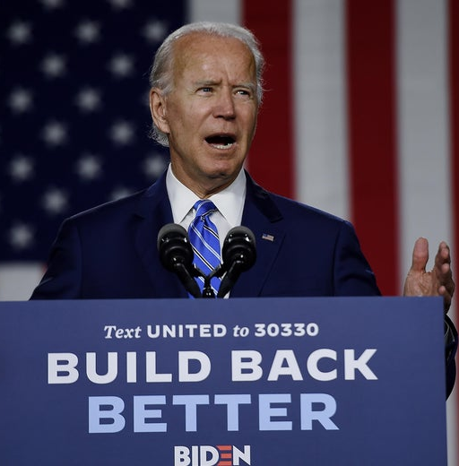
Implications of a Biden Win
• The “Build Back Better” theme characterizing Biden’s campaign has the power to stimulate economic growth.
• A Biden win implies major infrastructural developments, which are bound to improve the ease of conducting business.
• The promise to support the Green New Deal will facilitate economic development while ensuring minimal damage to the environment.
Notes:
The Biden campaign is founded on the “Build Back Better” economic policy theme, which includes a fiscal stimulus package that aims to address the immediate economic issues in the wake of a global pandemic. Additionally, the major infrastructural investments promised following a Biden win are bound to stimulate the economy significantly through ensuring the ease of movement of goods and services (Borowski et al., 2020). Furthermore, Biden has promised to support the modifications of the Green New Deal, a proposed legislation package that seeks to address the issues of climate change and economic inequality through social and economic reforms (Borowski et al., 2020). Among the most significant economic implications of this legislation is the creation of high-paying jobs.

Slide 8
Implications of a Biden Win (Cont.)
A Biden win presents ‘stability’ that can be translated into a stable environment for business growth and economic stability.
A Biden win would mean amendments of international relations between America and the East, facilitating international trade.
If Biden wins, there is a high chance for the restoration of the US-EU relations, whose deterioration has affected the manufacturing industry.
Notes:
Additionally, the 'stability' associated with Biden may translate to economic stability and create a stable environment for business growth if he wins the November elections. The potential Biden presidency is also bound to ease the ongoing capital war on foreign holdings, tech war, and the current economic tensions between the current administration and the East (Chu, 2020). Easing up these trade barriers would encourage international trade, thus, facilitate the development of the trade deal through improvements in international relations. Finally, a Biden win would see the restoration of positive US-EU relations, meaning that the current hurdles in manufacturing, particularly car manufacturing, would cease (Borowski et al., 2020).

Slide 9
Implications of a Balance of Power
Congress influences the implementation of fiscal policies developed by the federal government and affecting the economy.
Congress also has significant control over monetary policies, influencing the supply and circulation of money through the economy.
The House of Representatives determines federal government spending and taxation ratios.
Power interplay between Democrats and Republicans in the two houses determines the federal government's level of control over the economy.
Notes:
The United States Congress has significant influence over fiscal policies, which are directly associated with the federal budget, determining how market participants react and adjust pricing for their products (Potrafke, 2018). Therefore, where the president has no majority in Congress, it implies limited power and the ability to control fiscal policies to meet citizens' needs. Additionally, Congress has the power to influence the supply of money within the economy, determining credit controls, and the federal reserve, which controls monetary policies (Potrafke, 2018). Therefore, with powers in Congress, the government can have significant control over the economy. Similarly, power plays between the Democrats and Republicans in the House of Representatives may significantly influence the economy. The House determines federal spending and taxation, directly impacting the economy through the federal budget process (Potrafke, 2018).

Slide 10
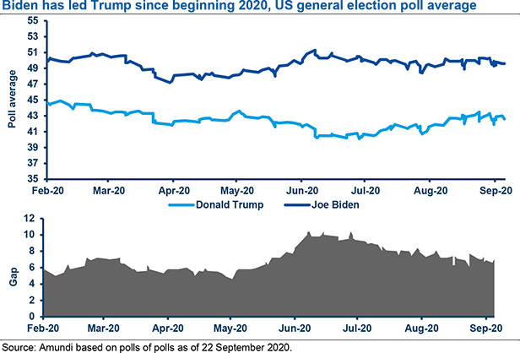
Quality Polls
• Joe Biden has maintained a steady lead over Donald Trump throughout the year.
• Most political betting sites have settled on Biden as the favorite candidate to win the election.
• The volatility and fluidity of polls contribute to increased outcome uncertainties.
• Factors like swing states, voting turnout, and the political debates have significant impacts on outcomes.
Notes:
Throughout the year, Biden has maintained a considerable lead over President Trump in the national polls by a 7.3% lead as of September 2020 (Borowski et al., 2020). However, Joe Biden's lead has significantly reduced from 10.4% lead in June 2020. Currently, political betting sites identify Biden as the favorite, with some sites giving him as high as a 60%-win rate (Borowski et al., 2020). Regardless of these, the outcomes remain uncertain as the polls’ trajectory is significantly fluid and volatile. Additionally, factors like the swing states, voting turnout, and political debates significantly impact the election outcomes (Borowski et al., 2020).

Slide 11
References
Borowski, D., Pirondini, M., Todd, C. & Upadhyaya, P. (2020). US Presidential Election: How It Will Impact Us Economy and Financial Markets. Amundi Asset Management. Retrieved from https://research-center.amundi.com/page/Article/Amundi-Views/2020/09/US-presidential-election-how-it-will-impact-US-economy-and-financial-markets
Lund, M. & Svendsen, A. (2020). Electionomics: The US election’s impact on the economy and financial markets. Open Insights by Nordea. Retrieved from https://insights.nordea.com/en/economics/us-election-economy/
Kingsly, K. (2016). The US Elections and Impact on Financial Markets with Zoom in Central Africa. Available at SSRN 2875967.
Potrafke, N. (2018). Government ideology and economic policy-making in the United States—a survey. Public Choice, 174(1-2), 145-207.

